Slide 1
Multivariate linear models for
regression and classification
1) linear classification
2) linear regression
3) logistic regression

Slide 2
Always start with a linear model:
Linear models are the least complex that still use
attributes as predictors in data mining
Non-linear models may reduce E_{in} but probably
will not generalize as well

Slide 3
All linear models optimize a linear combination of attributes,
x, that include a bias node with value of one.
Most convenient to represent linear combination as dot product,
w^{T}x, where the weights of attributes as predictors are
determined by minimum in-sample error.
w^{T}x is used differently in different types of linear models

Slide 4
Multivariate Linear Regression
(lecture 3 on amlbook.com)
In-sample error is the sum of squared deviations of w^{T}x^{t} from y^{t}

Slide 5
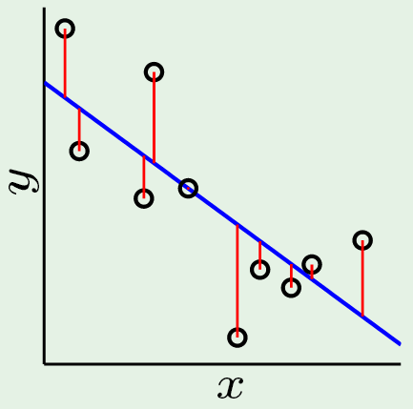
Polynomial Regression: degree 1 with N data points
Review: 1D linear regression (fit a line to data)
Solve V^{T}Vw = V^{T}y for w₁ and w₀
Lecture Notes for E Alpaydın 2010 Introduction to Machine Learning 2e © The MIT Press (V1.0)

Slide 6
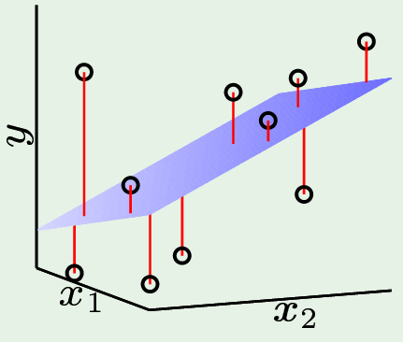
2 attributes determine the value of y In general {(y₁, x₁), (y₂, x₂), …,(y_{N} , x_{N})} is dataset with N examples of real numbers determined by d attributes
multivariate linear regression: fit a hyperplane to data
->
->
In matrix X, each row is a vector that combines x₀=1 with the d attributes of y.
Allows hypothesis to be written h(x)=w^{T}x, where w is vector with d+1 components.
Lecture Notes for E Alpaydın 2010 Introduction to Machine Learning 2e © The MIT Press (V1.0)

Slide 7
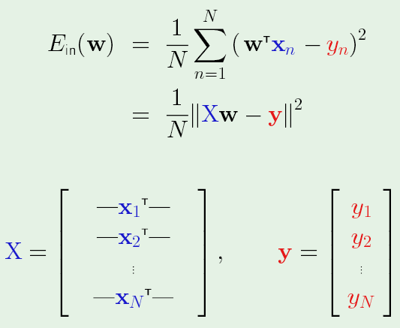
Finding the best hypothesis
h(x)=w^{T}x is an hypothesis set defined by the relative weight given to attributes that affect the value of y.
The best set of weights determined by minimizing the in-sample error defined by
As in polynomial fitting, Xw = y_{fit}

Slide 8
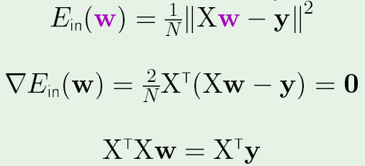
Just like the calculus used to find the best polynomial fit, setting the
gradient of in-sample error to zero gives “normal equations”, a linear
system of size (d+1) that determines that optimum weight vector w.
To solve normal equations, define A= X^{T}X, b=X^{t}y and solve Aw=b by
any efficient method. (w=A\b in MatLab)
Y_{fit} = Xw = are values of fit at the data points

Slide 9
Generalization of multivariate linear regression
Does small in-sample error guarantee small
out-of-sample error?
We expect from VC bound, E_{out}(g) = E_{in}(g) + O(d/N),
where g is the optimum hyperplane
For multivariate linear regression, we can show this
is true and find the value to which E_{out}(g) and E_{in}(g)
converge when N>>d.

Slide 10
Exercise 3.4 text p 87:
prove that the expected value of E_{in}(g) = σ²(1-(d+1)/N)
Like the derivation of bias/variance dilemma, proof is based on
the assumption that the target hyperplane is known and
datasets are target + noise.
Expectation is with respect to datasets of size N
X is matrix of attribute vectors,
Y is vector of observed values,
w* is the target weight vector, and
Y*=Xw* is vector of target values.
Assume Y=Y*+ε,
where ε is a vector of N random numbers drawn from a
normal distribution with zero mean and variance σ².

Slide 11
Using matrix algebra outlined in exercise 3.3 and 3.4 pages 87-88
E_{D}(E_{in}) = σ²( 1 – (d+1)/N)
and by similar methods (problem 3.11 page 112)
E_{D}(E_{out}) = σ²( 1 + (d+1)/N + O(1/N))

Slide 12
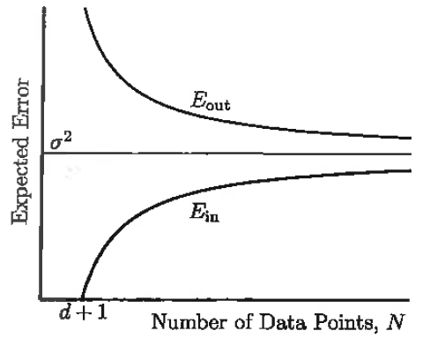
The “learning curve” for multivariate linear regression
learning curves show the gap between E_{in}
and E_{out} as a function of N
If learning is feasible, gap narrows as N increases
(VC generalization bound)

Slide 13
Learning curve for multivariate linear regression shows that
Uncertainty in the data ultimately determines that uncertainty of data-mining results.
At any finite N>d+1, E_{D}(E_{in}) < σ² means uncertainty has been under estimated because some of the noise has been misinterpreted as trend of the data.
At this sample size, we should expect E_{D}(E_{out}) to be larger than σ² by approximately the same amount.

Slide 14
Learning curve for multivariate linear regression also shows that
More data enables better discrimination between noise and underlying patterns we want to capture
Even though E_{in} increases with N, it becomes more reliable as a quality measure because the gap between E_{in} and E_{out} is smaller.

Slide 16
Multi-class selection by linear regression (also works for binary)
Example: Relate chemical composition of beer-bottle glass to brewery
Beer-bottle data contains 214 samples of bottle glass from 6 breweries.

Slide 17
First 3 rows of data
1 | 1.521 | 13.64 | 4.49 | 1.1 | 71.78 | 0.06 | 8.75 | 0 | 0 | 1
2 | 1.517 | 13.89 | 3.6 | 1.36 | 72.73 | 0.48 | 7.83 | 0 | 0 | 1
3 | 1.516 | 13.53 | 3.55 | 1.54 | 72.99 | 0.39 | 7.78 | 0 | 0 | 1
1. Sample index
2. RI: refractive index
3. Na: Sodium
4. Mg: Magnesium
5. Al: Aluminum
6. Si: Silicon
7. K: Potassium
8. Ca: Calcium
9. Ba: Barium
10. Fe: Iron
11. Type of bottle (class)
1=Anheuser-Busch, Inc.
2=Miller Brewing Co.
3=Blitz-Weinhard Brewing Co.
4=Pete’s Brewing Co.
5=Samuel Adams Brew House
6=Plank Road Brewery

Slide 18
Classification by regression
Setup multivariate linear regression with brewery number (column 11) as label
Solve normal equations for optimum weight vector
Calculate y_{fit}
Use y_{fit} to predict class for examples in dataset (bin results)
Use predicted class and true class to calculate a confusion matrix.
Use leave-one-out the estimate E_{test}

Slide 19
Confusion matrix
Confusion matrix for binary classification
# of true positives # of false negatives
# of false positives # of true negatives
total positives total negatives
Confusion matrix for multiple classes
# in class 1 assigned class 1 # in class 1 assigned class 2 …
# in class 2 assigned class 1 # in class 2 assigned class 2 … . .
. .
. .
# in class m assigned class 1 # in class m assigned class 2 …
total in class 1 total in class 2
Columns could be normalized by number in class (i.e. %)

Slide 20
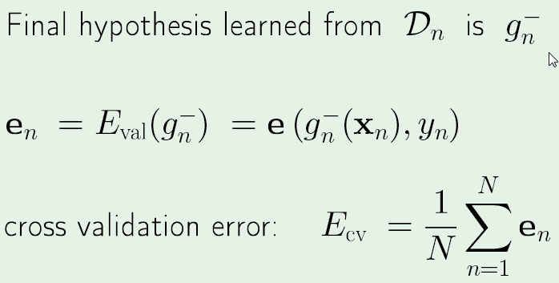
Review: “leave one out” N = number of samples
Do N learning problems each with N-1 samples.
e_{n} could be (g_{n}⁻ - y_{n})² but other options are available

Slide 21
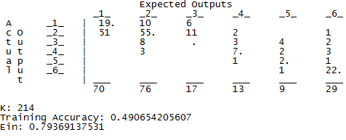
6-way confusion matrix for beer-bottle classification
Classes 1,2, and 6 have the most data. Data on class 3 is poor
Transpose of confusion matrix defined in slide 19
E_{in} : 0.79369137531 E_{cv-1}: 0.93933031526 MSSqR
E_{cv-1} > E_{in} means Accuracy_{cv-1} < Training Accuracy
By how much?
Use count as cross validation error.

Slide 22
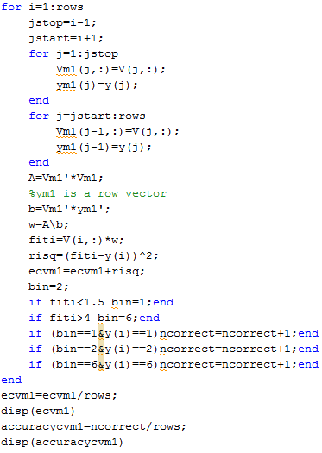
Estimate E_{test} by leave-one-out
3-way classification breweries 1, 2, and 6

Slide 23
Assignment 5: due 10-18-16
Apply linear regression to 1vs5 classification (text 81-88)
Attribute file (intensity, symmetry) with 424 examples is on class webpage.
1) Report in-sample error as mean sum squared residuals and number misclassified
2) Calculate 2x2 confusion matrix
3) Make a scatter plot of intensity vs symmetry (like text figure 3.2 p 83)
4) Include discriminant, w^{T}x=bin average, in plot as boundary between classes
5) Calculate E_{CV-1} by leave-one-out
6) Compare E_{CV-1} with E_{in} as mean sum squared residuals and number misclassified

Slide 25
Logistic Regression
(lecture 9 on amlbook.com)

Slide 26
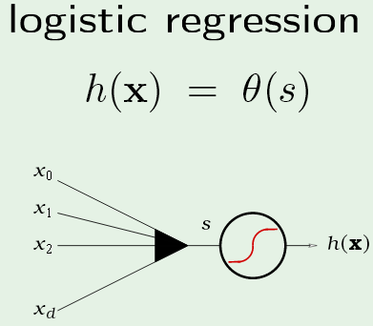
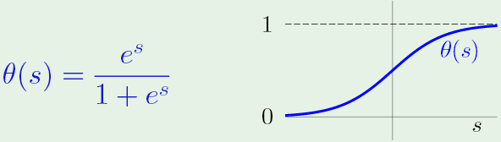
In logistic regression, s=w^{T}x become argument of a function with properties
like a probability distribution
w^{T}x = 0 is a
discriminant
x
w₀

Slide 27
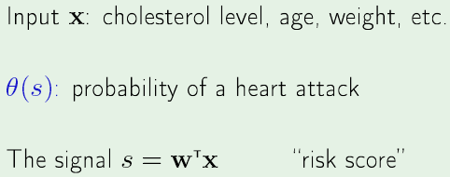
Application: risk of heart attack
Objective: find w such that risk score >> 0 for
patients that had a heart attack (θ(s) ~ 1) and
risk score << 0 for those who have not (θ(s) ~ 0).

Slide 28
More specifically (see text p91)
Assume that the data is drawn from a distribution function P(y|x),
which is related to hypothesis h(x) by
h(x_{n}) = P(y_{n}|x_{n}) if y_{n} = +1; h(x_{n}) = 1-P(y_{n}|x_{n}) if y_{n} = -1
Since the logistic function has the property θ(-s) = 1 – θ(s)
Both relationships are satisfied by P(y_{n}|x_{n}) = θ(y_{n}w^{T} x_{n})
Now use maximum likelihood estimation (MLE) to derive an
error function that we minimize to find the optimum w

Slide 29
Recall that MLE is used to
Estimate parameters of a probability distribution given
a sample X drawn from that distribution
In logistic regression, parameters are the weights
Likelihood of w given the sample X
l(w|X) = p (X |w) = ∏_{t} p(x^{t}|w)
Log likelihood
L(w|X) = log(l(w|X)) = ∑_{t} log p(x^{t}|w)
Choose w that maximizes L(w|X)
In logistic regression, p(x^{t}|w) = θ(y_{n}w^{T} x_{n})

Slide 30
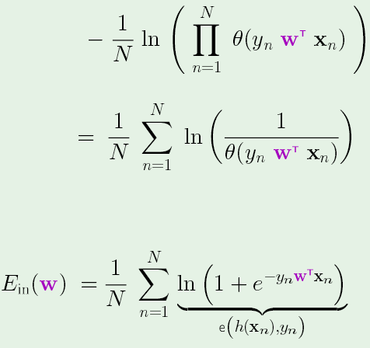
Since Log is a monotone increasing function, maximizing log(likelihood) is equivalent to minimizing -log(likelihood)
Text also normalizes by dividing by N; hence error function becomes
How?

Slide 31
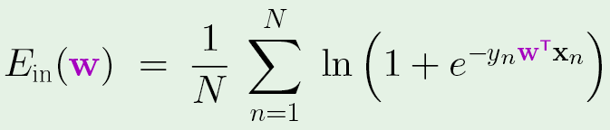
Error function of logistic regression (called cross entropy) has the
desired properties.
If x_{n} is attribute of person who has had a heart attack, w^{T}x_{n} >> 0
and y_{n} > 0 so contribution to E_{in}(w) is small.
If x_{n} are attributes of person who has not had a heart attack,
w^{T}x_{n} << 0 and y_{n} < 0 so contribution to E_{in}(w) is again small.
w^{T}x_{n} is the risk of a heart attack for n^{th} subject

Slide 32
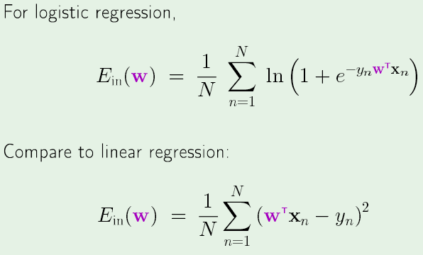
Error function of linear regression allows “1-step” optimization.
Not true for error function of logistic regression
Optimization is iterative; one method is “gradient decent”

Slide 33
Stochastic gradient decent: correct weights by error in each data point
derive this result
η is “learning rate” with value << 1

Slide 34
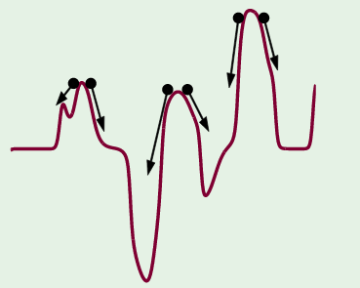
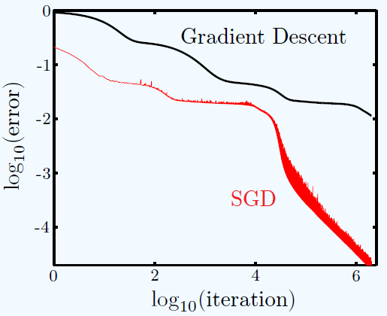
Benefits of stochastic gradient decent
Less computation than Batch gradient decent
Randomness helps avoid getting stuck in local minima

Slide 35

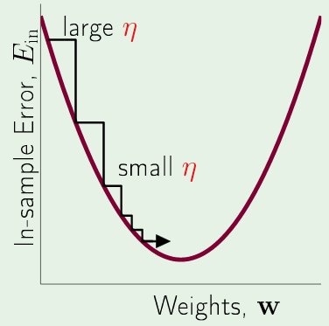
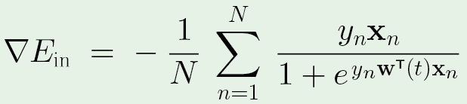
Batch gradient decent fixed leaning rate η
w(1) = w(0) + Δ w
Weights change fastest where gradient is largest
Note: sum of vectors

Slide 36
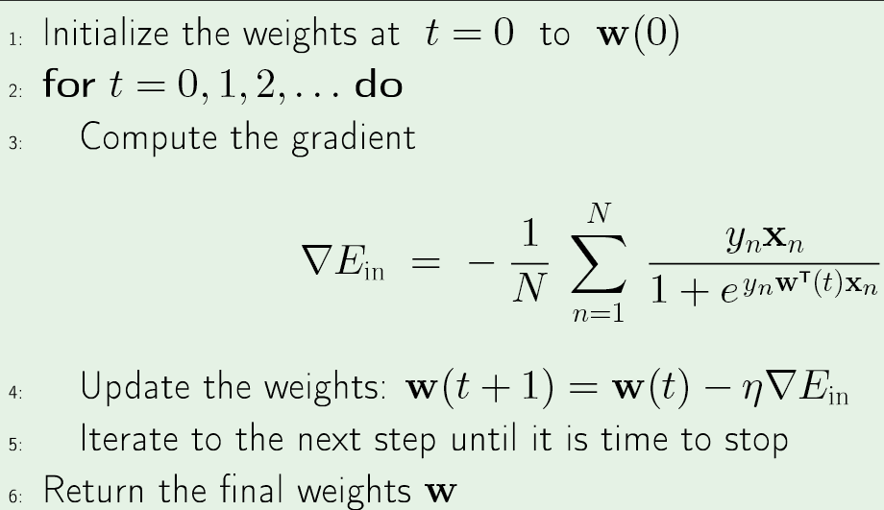
Logistics regression algorithm

Slide 37
Chose w(0) randomly on [0,1]
A learning rate of 0.001 or less is good
How do you avoid overflow in calculation of
the gradient of E_{in} ?

Slide 38
How do you known when to stop?
Max iterations: typically 50,000
Small norm of gradient: typically < 0.01
Small E_{in} : typically < 0.5
How do you avoid underflow in the calculation of E_{in}?

Slide 39
Joe’s results (not converged)
iterations: 100
Learning rate: 0.0005
Final weights: 0.5964, 0.9967, 0.9850, 0.0719, -0.1431, 0.9982, 0.9960, -0.1344, 1.0009, 0.9987, 0.9910, 1.0020, 0.9804
E_{in}(mean cross entropy)= 2.2766 at termination
Accuracy = 0.6812
high risk low risk <- classified as
94 44 138 total high risk
51 109 160 total low risk

Slide 40
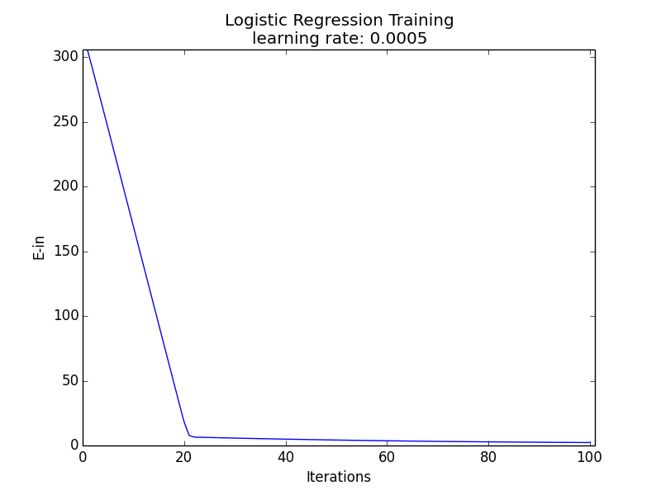

Slide 41
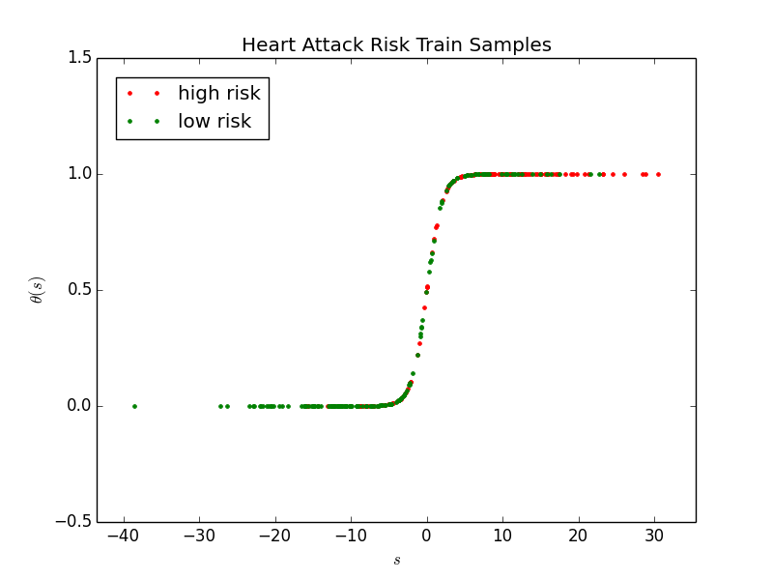
Probability of a heart attack

Slide 42
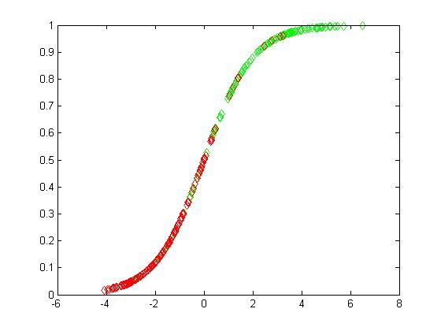
Heng Wang cpts534 fall 2015
η = 0.0001, iteration = 50000, Ein = 0.372709312473342, Accuracy = 0.845117845117845
 | Expected Low risk | Expected High risk
Actual Low Risk | 142 | 28
Actual High Rish | 18 | 109
total | 160 | 137

Slide 43
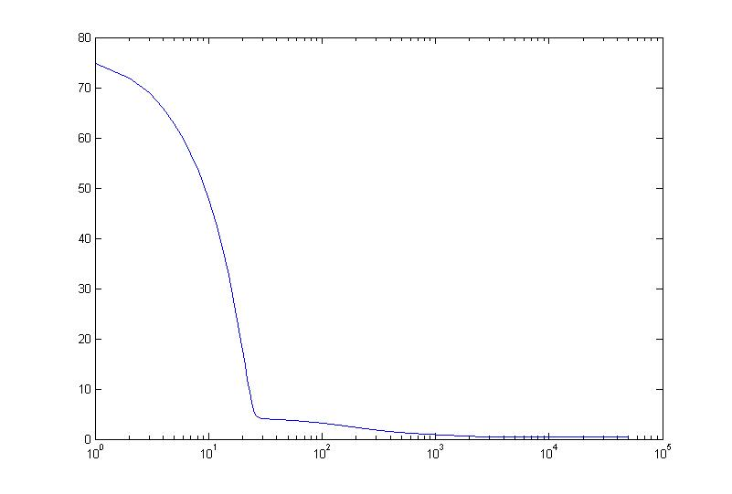
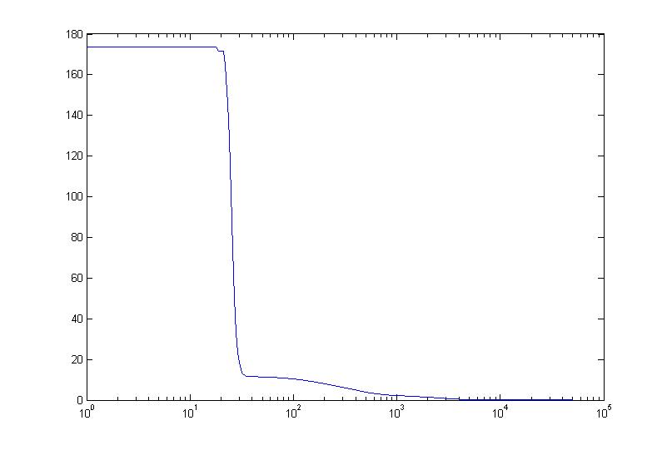
Ein VS iteration
Norm grad(Ein) VS iteration

Slide 44
Expanded Assignment 6: Due 10-25-16
Start WEKA 3.8 and start the “Explorer window”
On the Preprocess tab, open the “logit-data.csv” file
Filter the data by clicking on “Choose” button -> filters -> unsupervised -> attribute -> NumericToNominal, then click “Apply” to generate a .arff
Go to the “Classify” tab and click the “Choose” button. Choose “SimpleLogistic” classifiers under “functions”.
Run with default settings and 10-fold cross-validation.
Include the results summary and confusion matrix in your report
Right-click in the result list to open visualization options. Include class-specific ROC curves in your report.
Return to the “Classify” tab and “Logistic” classifiers under “functions”.
Run with default settings and 10-fold cross-validation.
Include the results summary and confusion matrix in your report
The secret to the success of Simple Logistics may be its automatic attribute selection. In the output for Simple Logistics, find the attributes in be base case. Modify the excel file of logistic data to include only these attributes and rerun the Logistics case with default settings and 10-fold cross-validation. Include the results summary and confusion matrix in your report.

Slide 45
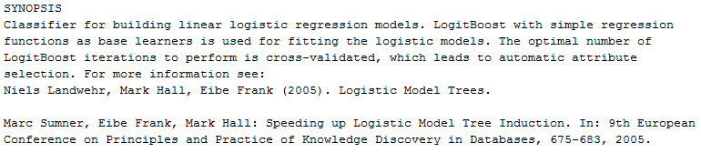
Weka’s Simple Logistic

Slide 46
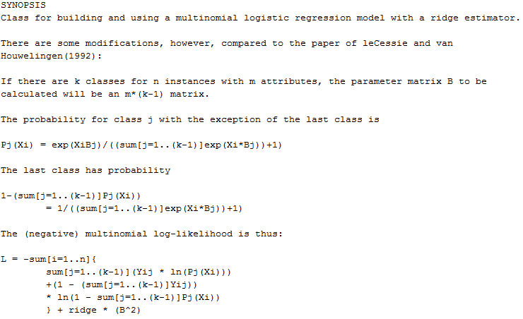
Weka’s Logistic Regression

Slide 47
More on multidimensional optimization

Slide 48
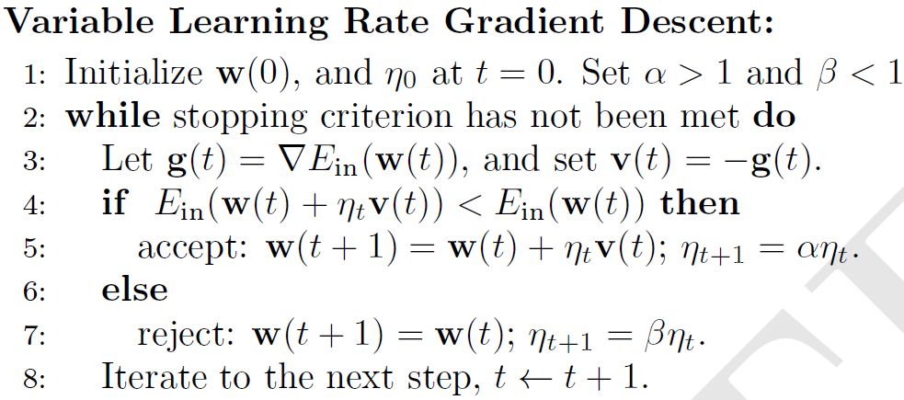
Improving convergence of gradient decent (e-chapter 7)
If you have access to MatLab’s optimization package, try it
Typical values: α = 1.05 to 1.1 β = 0.5 to 0.8

Slide 49
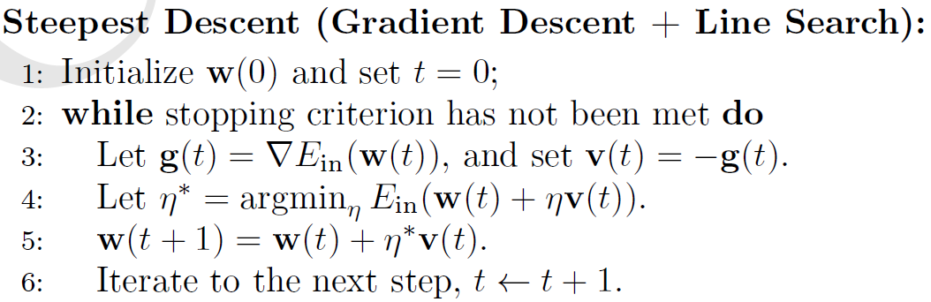

Slide 50
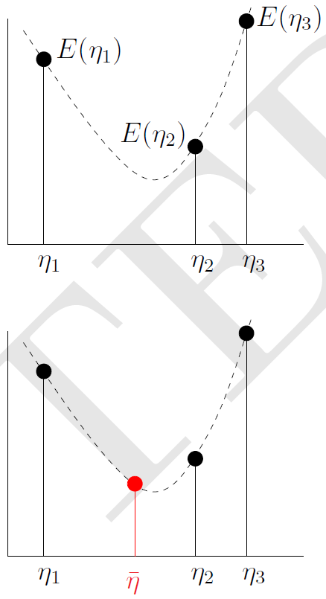
Find η₁, η₂ and η₃ such that η₁ < η₂ < η₃ and
and E(η₂) < min( E(η₁), E(η₃))
Guess η = (η₁ + η₃ )/2 as solution of line search
If E(η) < E(η₂) repeat with η₁ < η < η₂ (shown)
If E(η) > E(η₂) repeat with η < η₂ < η₃
Stop when E(η_{k+1}) ~ E(η_{k}) or max iterations
To find initial set of η’s, start with η₁ = 0 and η₃ = ε
If E(η₂) < E(η₁) try η = 0, ε, 2ε, 4ε, etc. until E increases
If E(η₂) > E(η₁) try η = ε, 0, −2ε, −4ε, etc. until E increases

Slide 51
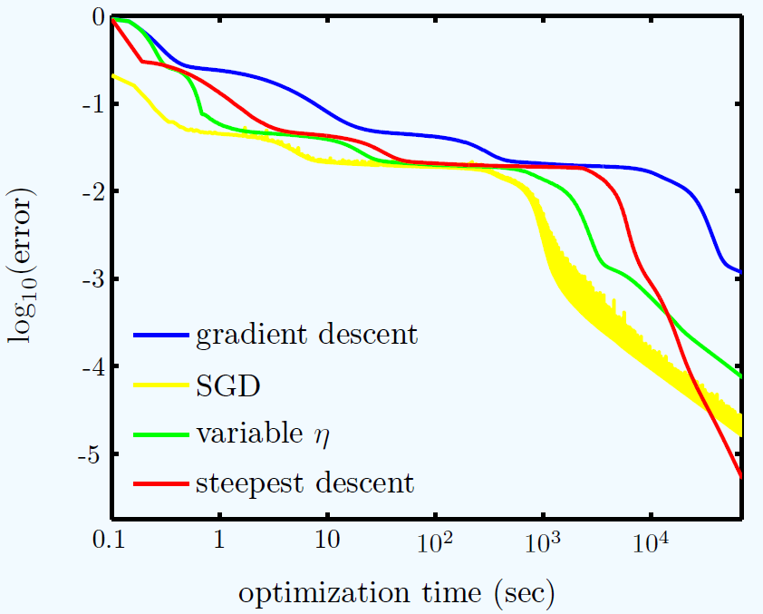

Slide 52
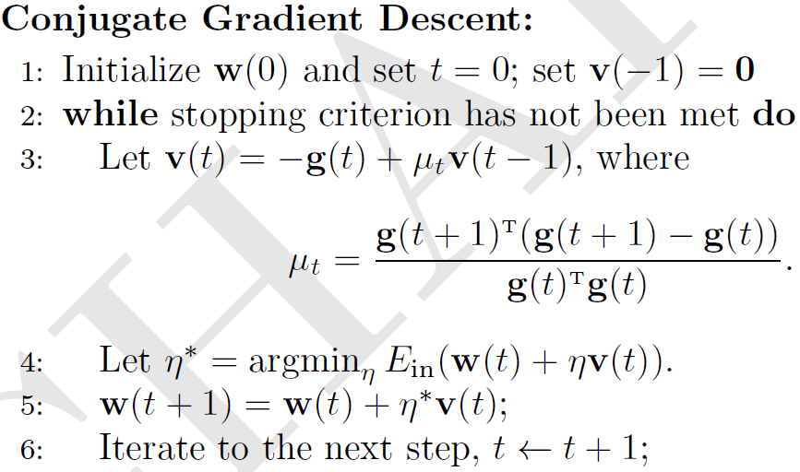
After a few conjugate gradient iterations, do an iterations with μ = 0
(i.e. steepest decent)

Slide 53
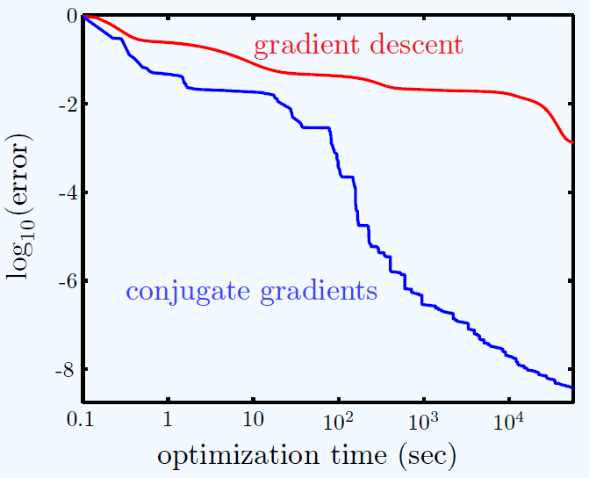

Slide 54
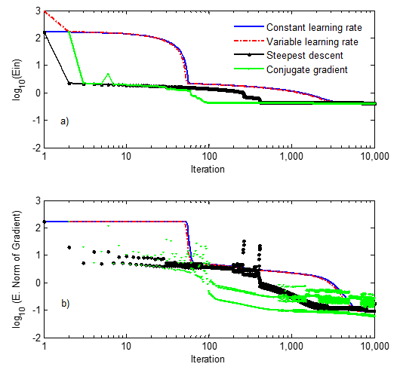
Edom’s results on optimization methods leaning rate = 0.001
Conclusions:
All methods, except constant leaning rate,
are stable with leaning rate as high as 0.001.
For stability, momentum term of conjugate
gradient set to zero on ever other iteration.
Line search by bisection method significantly
decreases speed per iteration.
In norm of gradient, see evidence of multiple
local minima.

